Slide 1

Reinforcement Learning
Naeemullah Khan
naeemullah.khan@kaust.edu.sa
KAUST Academy
King Abdullah University of Science and Technology

Slide 2
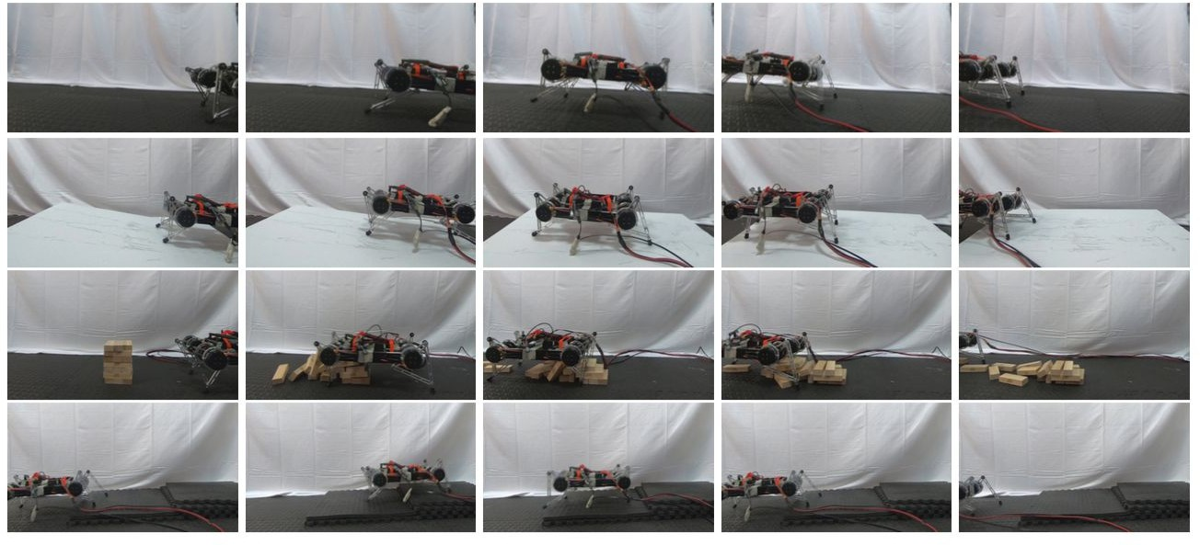
Soft Actor-Critic:
Off-Policy Maximum Entropy Deep Reinforcement Learning with a Stochastic Actor
Tuomas Haarnoja, Aurick Zhou, Pieter Abbeel, Sergey Levine

Slide 3
Main Problem: Sample Inefficiency
Number of times the agent must interact with the environment in order to learn a task
Good sample complexity is the first prerequisite for successful skill acquisition.
Learning skills in the real world can take a substantial amount of time
can get damaged through trial and error

Slide 4
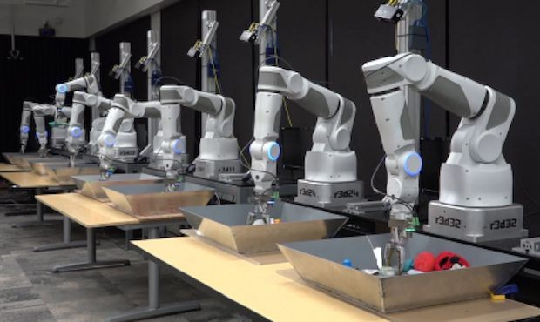
Main Problem: Sample Inefficiency
"Learning Hand-Eye Coordination for Robotic Grasping with Deep Learning and Large-Scale Data Collection", Levine et al., 2016
14 robot arms learning to grasp in parallel
objects started being picked up at around 20,000 grasps
https://spectrum.ieee.org/automaton/robotics/ artificial-intelligence/google-large-scale-roboti c-grasping-project

Slide 5
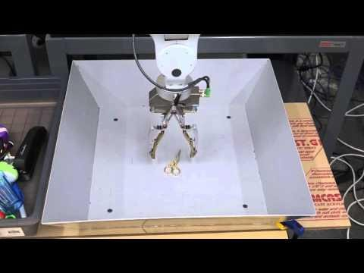
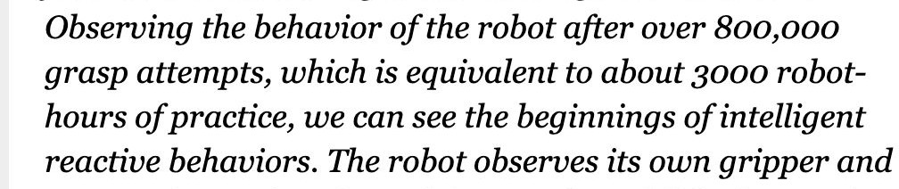
Main Problem: Sample Inefficiency
https://www.youtube.com/watch?v=cXaic_k80uM

Slide 6
Main Problem: Sample Inefficiency
Solution?
Off-Policy Learning!

Slide 7
Background: On-Policy vs. Off-Policy
On-policy learning:
use the deterministic outcomes or samples from the target
policy to train the algorithm
has low sample efficiency (TRPO, PPO, A3C)
require new samples to be collected for nearly every update to the policy
becomes extremely expensive when the task is complex
Off-policy methods:
training on a distribution of transitions or episodes
produced by a different behavior policy rather than that produced by the target
policy
○
Does not require full trajectories and can reuse any past episodes
(experience replay) for much better sample efficiency
relatively straightforward for Q-learning based methods

Slide 8
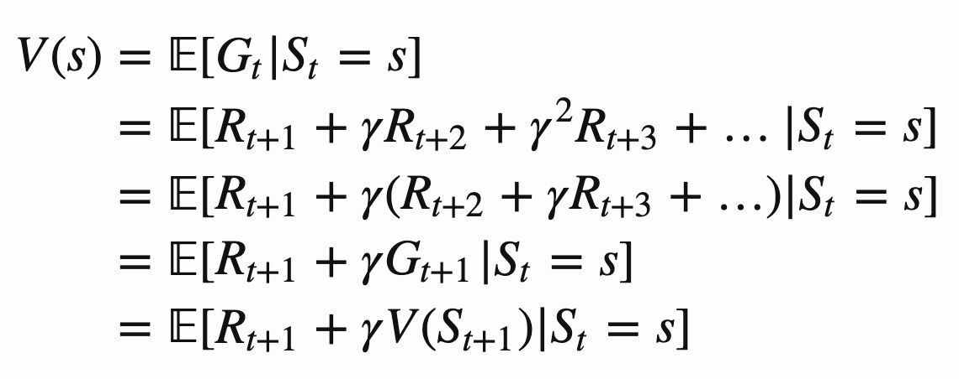
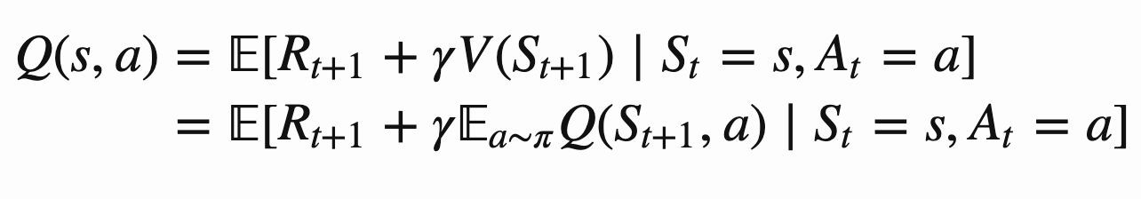
Background: Bellman Equation
Value Function: How good is a state?
temporal difference target
Similarly, for Q-Function: How good is a state-action pair?

Slide 9
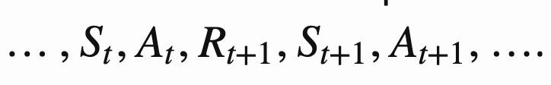
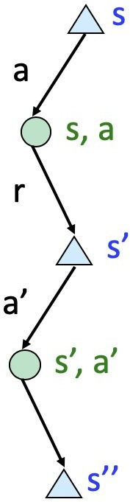

Background: Value-Based Method
(on-policy):
Q-Learning (off-policy)
DQN, Minh et al., 2015
Function Approximation
Experience Replay: samples randomly drawn from replay memory
Doesn’t scale to continuous action space

Slide 10
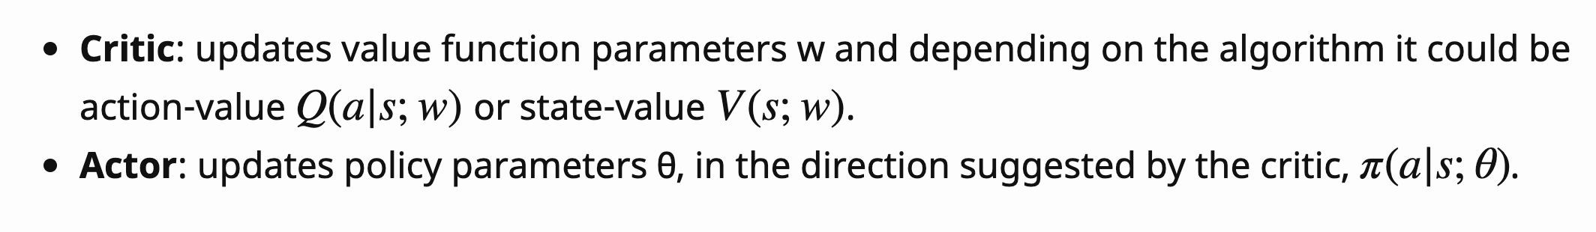

Background: Policy-Based Method (Actor-Critic)
policy gradient
update actor
correction for action-value update critic
https://lilianweng.github.io/lil-log/2018/02/19/a-long-peek-into-reinforcement-learning.html#actor-critic

Slide 11
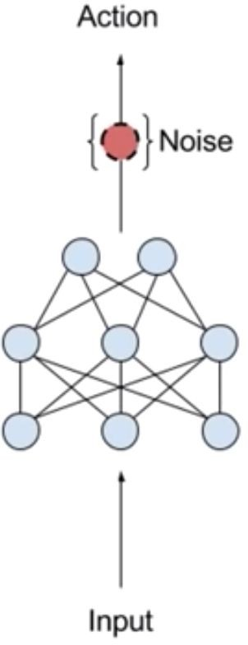
Prior Work: DDPG
DDPG = DQN + DPG (Lillicrap et al., 2015)
off-policy actor-critic method that learns a deterministic policy in continuous domain
exploration noise added to the deterministic policy when select action
difficult to stabilize and brittle to hyperparameters (Duan et al., 2016, Henderson et al., 2017)
unscalable to complex tasks with high dimensions (Gu et al., 2017)
https://www.youtube.com/watch?v=zR11FLZ-O9M&t=2145s

Slide 12
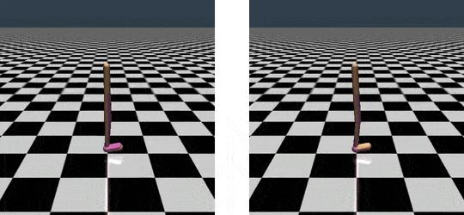
Main Problems: Robustness
Training is sensitive to randomness in the environment, initialization of the policy and the algorithm implementation
https://gym.openai.com/envs/Walker2d-v2/

Slide 13
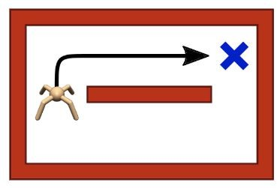
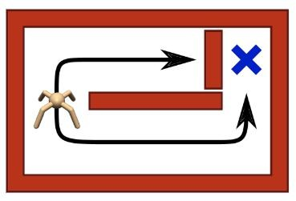
Main Problems: Robustness
Knowing only one way to act makes agents vulnerable to environmental changes that are common in the real-world
https://bair.berkeley.edu/blog/2017/10/06/soft-q-learning/

Slide 14
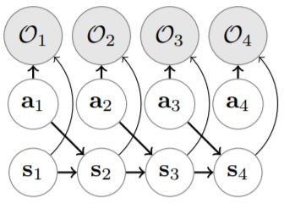
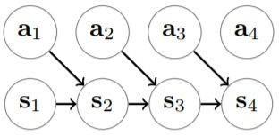
Background: Control as Inference
Traditional Graph of MDP
Graphical Model with Optimality Variables

Slide 15


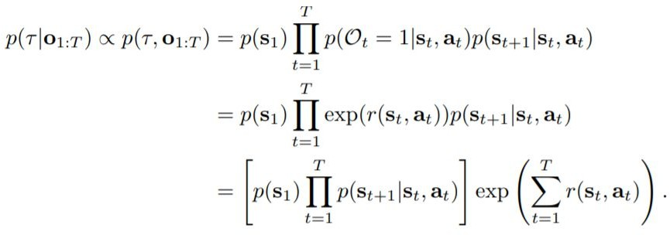
Background: Control as Inference
Normal trajectory distribution
Posterior trajectory distribution

Slide 16
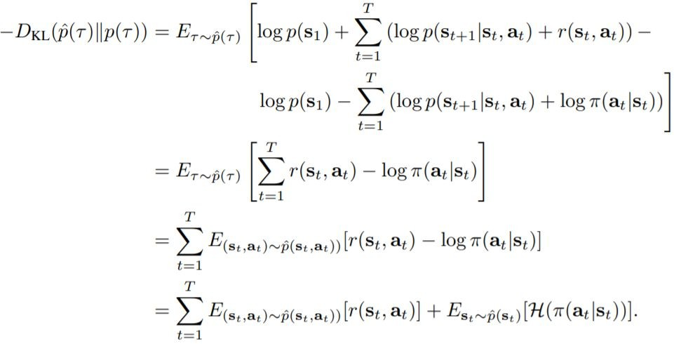
Background: Control as Inference
Variational Inference

Slide 17

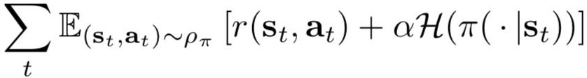
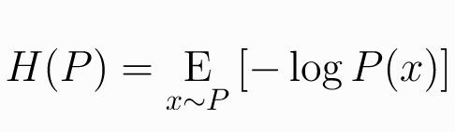
Background: Max Entropy RL
Conventional RL Objective - Expected Reward
Maximum Entropy RL Objective - Expected Reward + Entropy of Policy
Entropy of a RV x

Slide 18
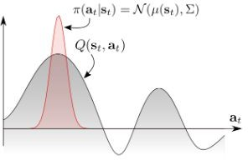
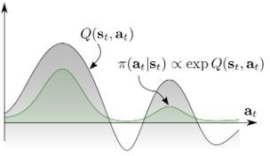
Max Entropy RL
MaxEnt RL agent can capture different modes of optimality to improve robustness against environmental changes
https://bair.berkeley.edu/blog/2017/10/06/soft-q-learning/

Slide 19
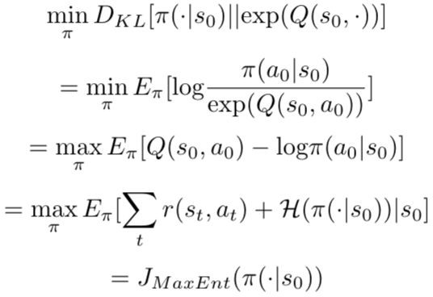
Max Entropy RL

Slide 20
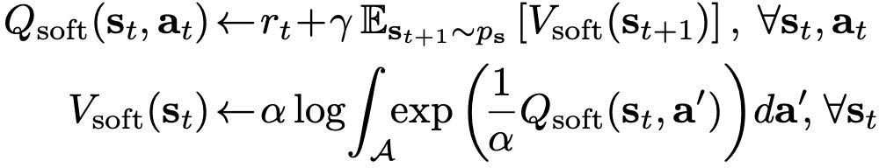
Prior Work: Soft Q-Learning
Soft Q-Learning (Haarnoja et al., 2017)
off-policy algorithms under MaxEnt RL objective
Learns Q* directly
Intead of taking max action, sample the action
use approximate inference methods to sample
Stein variational gradient descent
not true actor-critic

Slide 21
SAC: Contributions
One of the most efficient model-free algorithms
SOTA off-policy
well suited for real world robotics learning
Can learn stochastic policy on continuous action domain
Robust to noise
Ingredients:
Actor-critic architecture with seperate policy and value function networks
Off-policy formulation to reuse of previously collected data for efficiency
Entropy-constrained objective to encourage stability and exploration

Slide 22

Soft Policy Iteration: Policy Evaluation
policy evaluation: compute value of π according to Max Entropy RL Objective
modified Bellman backup operator T:
Lemma 1: Contraction Mapping for Soft Bellman Updates
converges to the soft Q-function of π

Slide 23
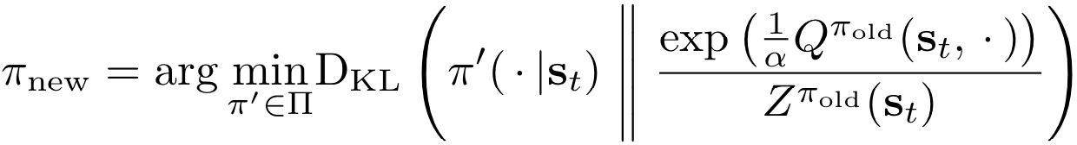
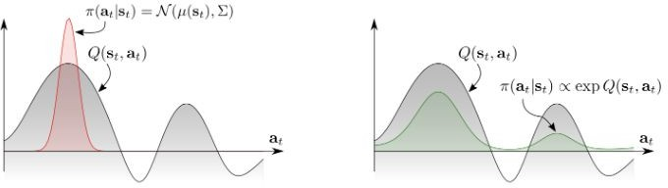
Soft Policy Iteration: Policy Improvement
policy improvement: update policy towards the exponential of the new soft Q-function
modified Bellman backup operator T:
choose tractable family of distributions big Π
choose KL divergence to project the improved policy into big Π
Lemma 2
for any state action pair

Slide 24
Soft Policy Iteration
soft policy iteration: soft policy evaluation <-> soft policy improvement
Theorem 1: Repeated application of soft policy evaluation and soft policy improvement from any policy converges to the optimal MaxEnt policy among all policies in
exact form applicable only in discrete case
need function approximation to represent Q-values in continuous domains
-> Soft Actor-Critic (SAC)!

Slide 25






SAC - Parameterized soft Q-function
e.g.neural network
parameterized tractable policy
e.g. Gaussian with mean and covariances given by neural networks
soft Q-function objective and its stochastic gradient wrt its parameters
policy objective and stochastic gradient wrt its parameters

Slide 26

SAC: Objectives and Optimization
Critic - Soft Q-function
minimize square error
exponential moving average of soft Q-function weights to stabilize training (DQN)

Slide 27


SAC: Objectives and Optimization
Actor - Policy
multiply by alpha and ignoring the normalization Z
reparameterize with neural network f
epsilon: input noise vector, sampled from a fixed distribution (spherical Gaussian)
Unbiased gradient estimator that extends DDPG stype policy gradients to any tractable stochastic policy

Slide 28
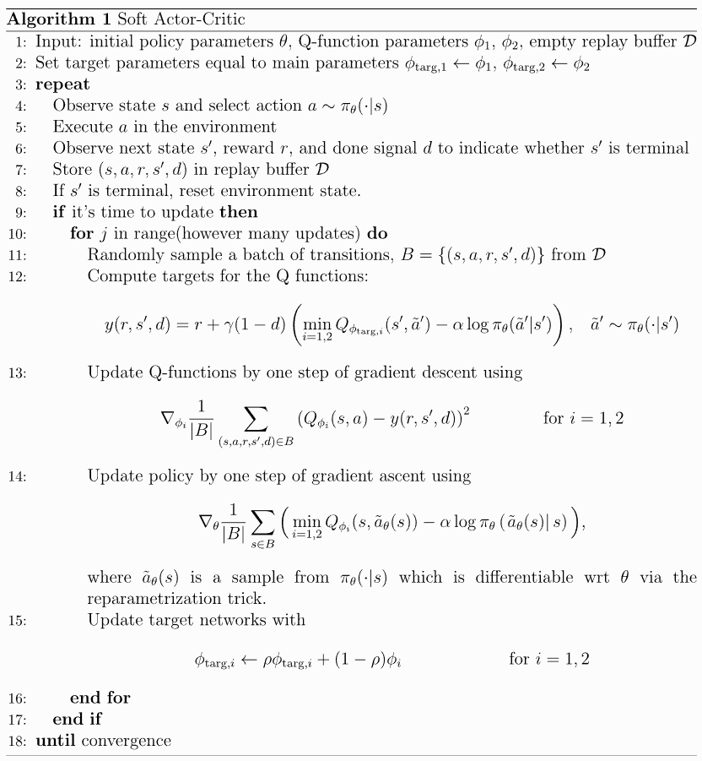
SAC: Algorithm
https://spinningup.openai.com/en/latest/algorithms/sac.html

Slide 29
Experimental Results
Tasks
A range of continuous control tasks from the OpenAI gym benchmark suite
RL-Lab implementation of the Humanoid task
The easier tasks can be solved by a wide range of different algorithms, the more complex benchmarks, such as the 21-dimensional Humanoid (rllab) are exceptionally difficult to solve with off-policy algorithms.
Baselines:
DDPG, SQL, PPO, TD3 (concurrent)
TD3 is an extension to DDPG that first applied the double Q-learning trick to continuous control along with other improvements.
https://arxiv.org/abs/1801.01290

Slide 30
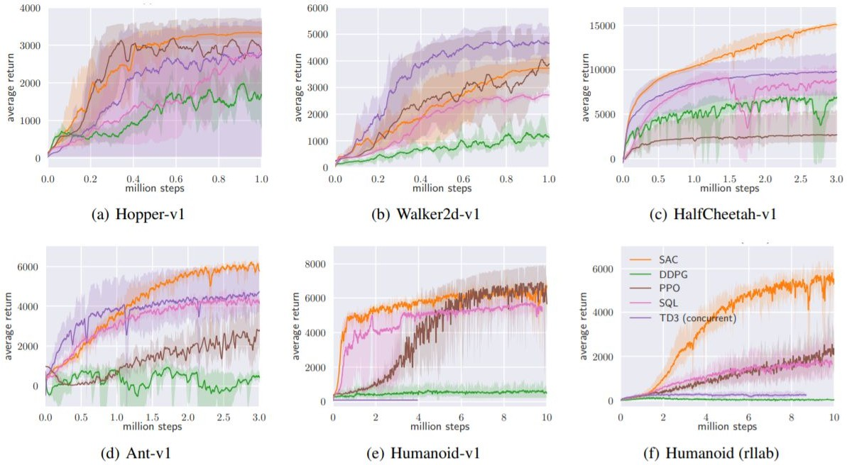
SAC: Results

Slide 31
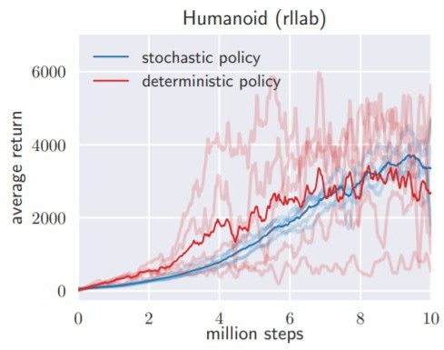
Experimental Results: Ablation Study
How does the stochasticity of the policy and entropy maximization affect the performance?
Comparison with a deterministic variant of SAC that does not maximize the entropy and that closely resembles DDPG
https://arxiv.org/abs/1801.01290

Slide 32
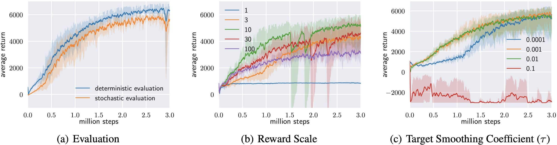
Experimental Results: Hyperparameter Sensitivity
https://arxiv.org/abs/1801.01290

Slide 33
Limitation
Unfortunately, SAC also suffers from brittleness to the alpha temperature hyperparameter that controls exploration
-> automatic temperature tuning!

Slide 34
Contributions
Adaptive temperature coefficient
temperature
Extend to real-world tasks such as locomotion for a quadrupedal robot and robotic manipulation with a dexterous hand
https://arxiv.org/abs/1801.01290

Slide 35
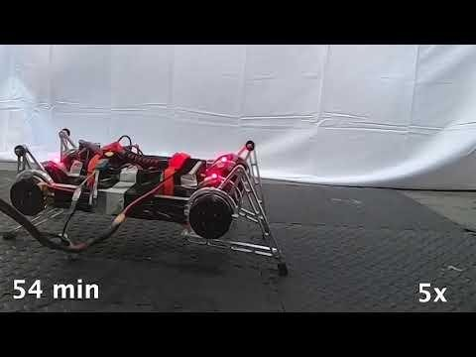
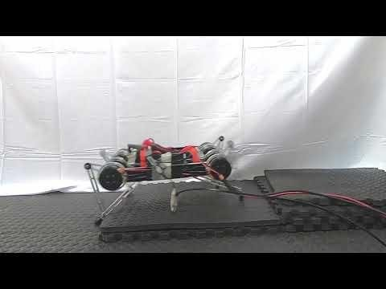
Real World Robots
https://arxiv.org/abs/1801.01290

Slide 36
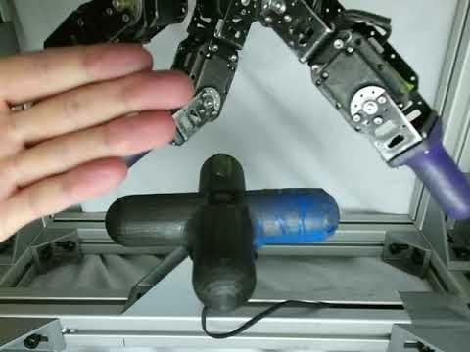
Real World Robots
Dexterous Hand Manipulations
20 hour end-to-end learning
valve position as input: SAC 3 hours vs. PPO 7.4 hours
https://sites.google.com/view/sac-and-applications

Slide 37
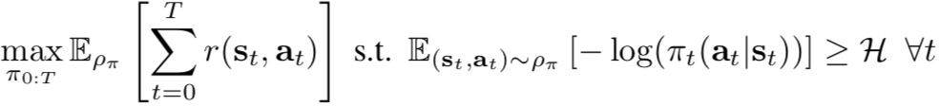
Automatic Temperature Tuning
Choosing the optimal temperature is non-trivial (tuned for each task)
Constrained optimization problem:
https://arxiv.org/abs/1801.01290

Slide 38


Dual Problem for the Constrained Optimization
Unroll the expectation
For the last time step in the trajectory

Slide 39
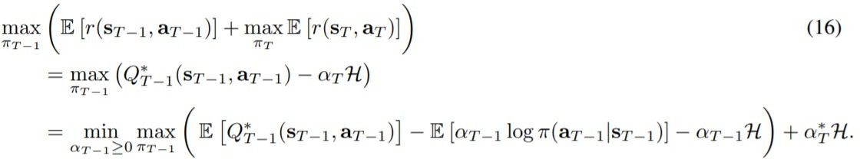
Dual Problem for the Constrained Optimization
Similarly, for the previous time step

Slide 40
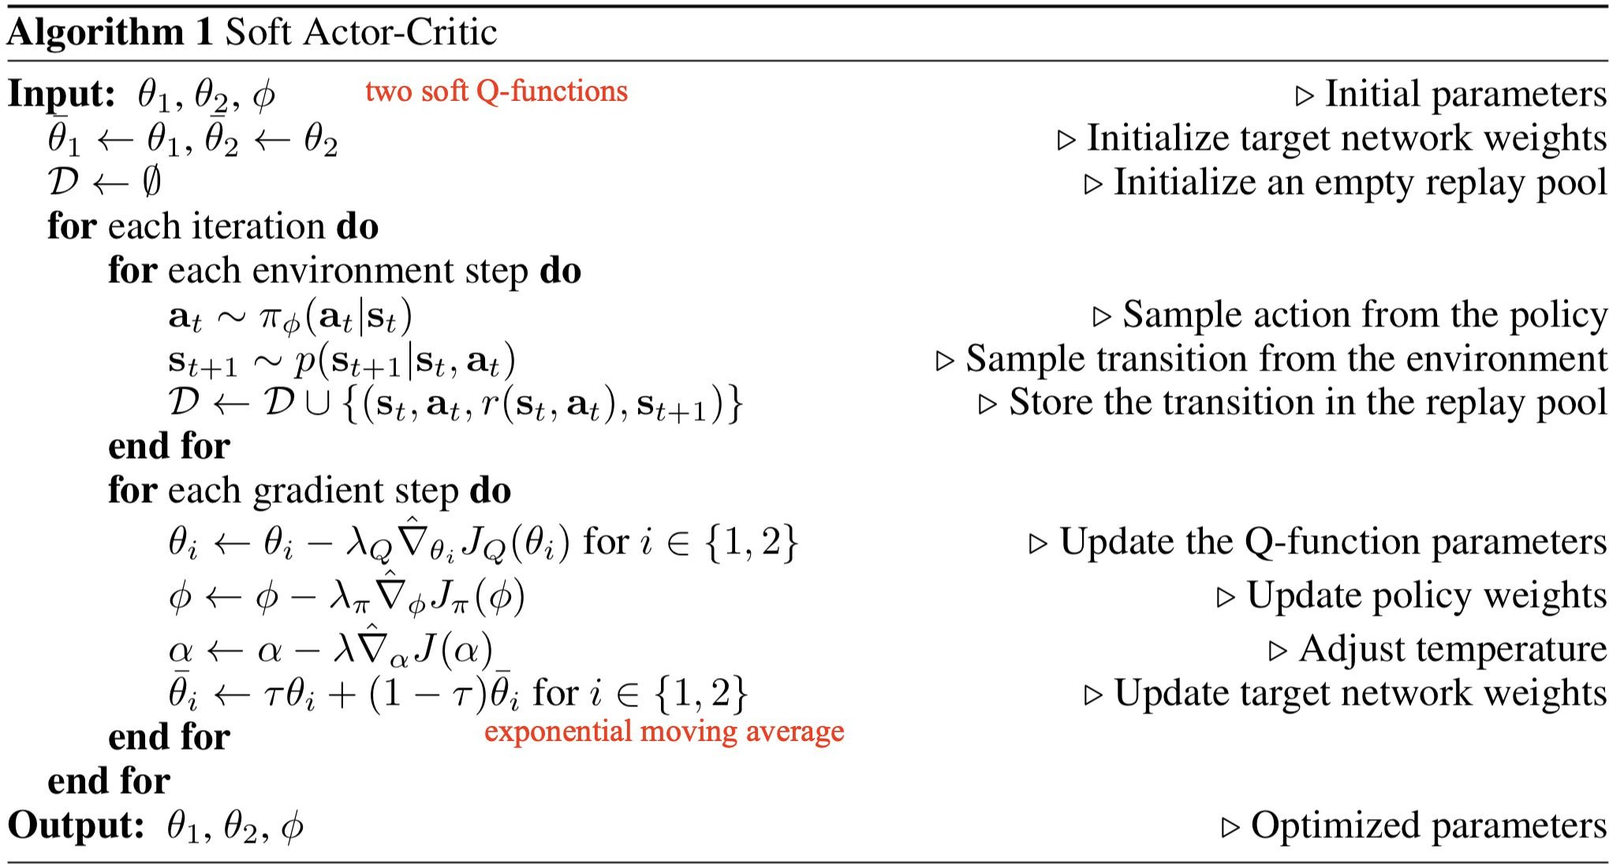

Slide 41
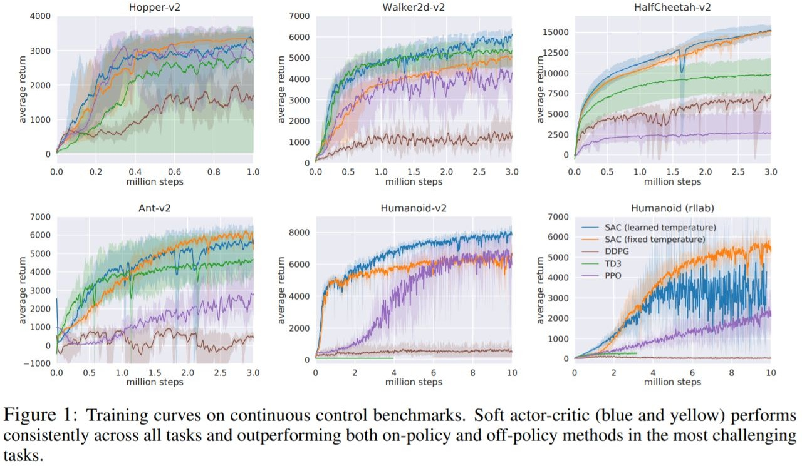
Experimental Results: RL Lab
https://arxiv.org/abs/1801.01290

Slide 42
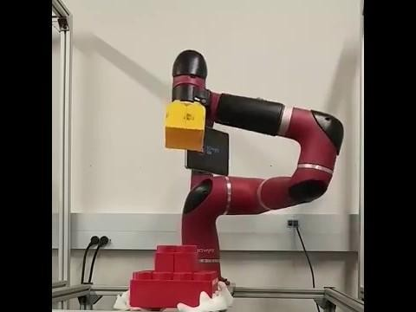
Experimental Results: Robustness

Slide 43
Limitations/Open Issues
Lack of experiments on hard-exploration problem

Slide 44
Limitations/Open Issues
Lack of experiments on hard-exploration problem
Approximating a multi-modal Boltzmann distribution with a unimodal Gaussian

Slide 45
Limitations/Open Issues
Lack of experiments on hard-exploration problem
Approximating a multi-modal Boltzmann distribution with a unimodal Gaussian
High-variance using automatic temperature tuning

Slide 46
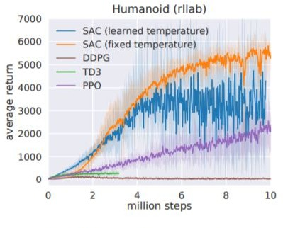
Limitations/Open Issues
Lack of experiments on hard-exploration problem
Approximating a multi-modal Boltzmann distribution with a unimodal Gaussian
High-variance using automatic temperature tuning

Slide 47
Recap: SAC
An off-policy maximum entropy deep reinforcement learning algorithm
Sample-efficient
Scale to high-dimensional observation/action space
Robustness to random seed, noise and etc.
Theoretical Results
Convergence of soft policy iteration
Derivation of soft-actor critic algorithm
Empirical Results
SAC outperforms SOTA model-free deep RL methods, including DDPG, PPO and Soft Q-learning, in terms of the policy’s optimality, sample complexity and robustness.

Slide 48
References
These slides have been adapted from
Animesh Garg, CSC2621: Reinforcement Learning in Robotics, University of Toronto

